Slide 1
CAPSTONE FINAL PROJECT
Suitable New Store Locations in Paris for a Fashion Retailer

Slide 2
This presentation contains multiple parts:
1.A description of the problem and a discussion of the background
2.A description of the data and how it will be used to solve the problem
3.Methodology and Exploratory Data Analysis
4.Inferences and Discussion

Slide 3
The Data Science Workflow
Data Requirements
Outline the initial data that is required:
District data for Paris including names, location data if available, and any other details required.
Obtain the Data:
Research and find suitable sources for the district data for Paris.
Access and explore the data to determine if it can be manipulated for our purposes.
Initial Data Wrangling and Cleaning:
Clean the data and convert to a useable form as a dataframe.

Slide 4
The Data Science Workflow for parts 3 & 4 includes:
Data Analysis and Location Data:
Foursquare location data will be leveraged to explore or compare districts around Paris.
Data manipulation and analysis to derive subsets of the initial data.
Identifying the high traffic areas using data visualisation and tatistical analysis.
Visualization:
Analysis and plotting visualizations.
Data visualization using various mapping libraries.
Discussion and Conclusions:
Recomendations and results based on the data analysis.
Discussion of any limitations and how the results can be used, and any conclusions that can be drawn.

Slide 5
Data Research and Preparation
Import the Paris District Data
Arrondissements Municipaux for Paris CSV (administrative districts)
Paris is divided into 20 Arrondissements Municipaux (or administrative districts), shortened to just arrondissements.
They and normally referenced by the arrondissement number rather than a name.
Data for the arrondissements is necessary to select the most suitable of these areas for new stores.

Slide 6
Exploring, Wrangling and Cleaning the Data
Clean up the dataset to remove unnecessary columns
Discussion of the Business Objective and Problem / The Data Workflow
We now have located and imported the relevant data for the districts of Paris, and have constructed a dataframe.
Our business objective, strategy and methods to achieve our goal have been laid out, and a data workflow established.
Next up, we will leverage Foursquare location data to obtain data on high traffic areas - where consumers go for shopping, restaurants and entertainment

Slide 7
3 Methodology and Exploratory Data Analysis
The Data Science Workflow for parts 3 & 4 includes:
Data Analysis and Location Data:
Foursquare location data will be leveraged to explore or compare districts around Paris
.
Data manipulation and analysis to derive subsets of the initial data.
Identifying the high traffic areas using data visualisation and tatistical nalysis.

Slide 8
Visualization:
Analysis and plotting visualizations.
Data visualization using various mapping libraries.
Discussion and Conclusions:
Recomendations and results based on the data analysis
.
Discussion of any limitations and how the results can be used, and any conclusions that can be drawn.

Slide 9
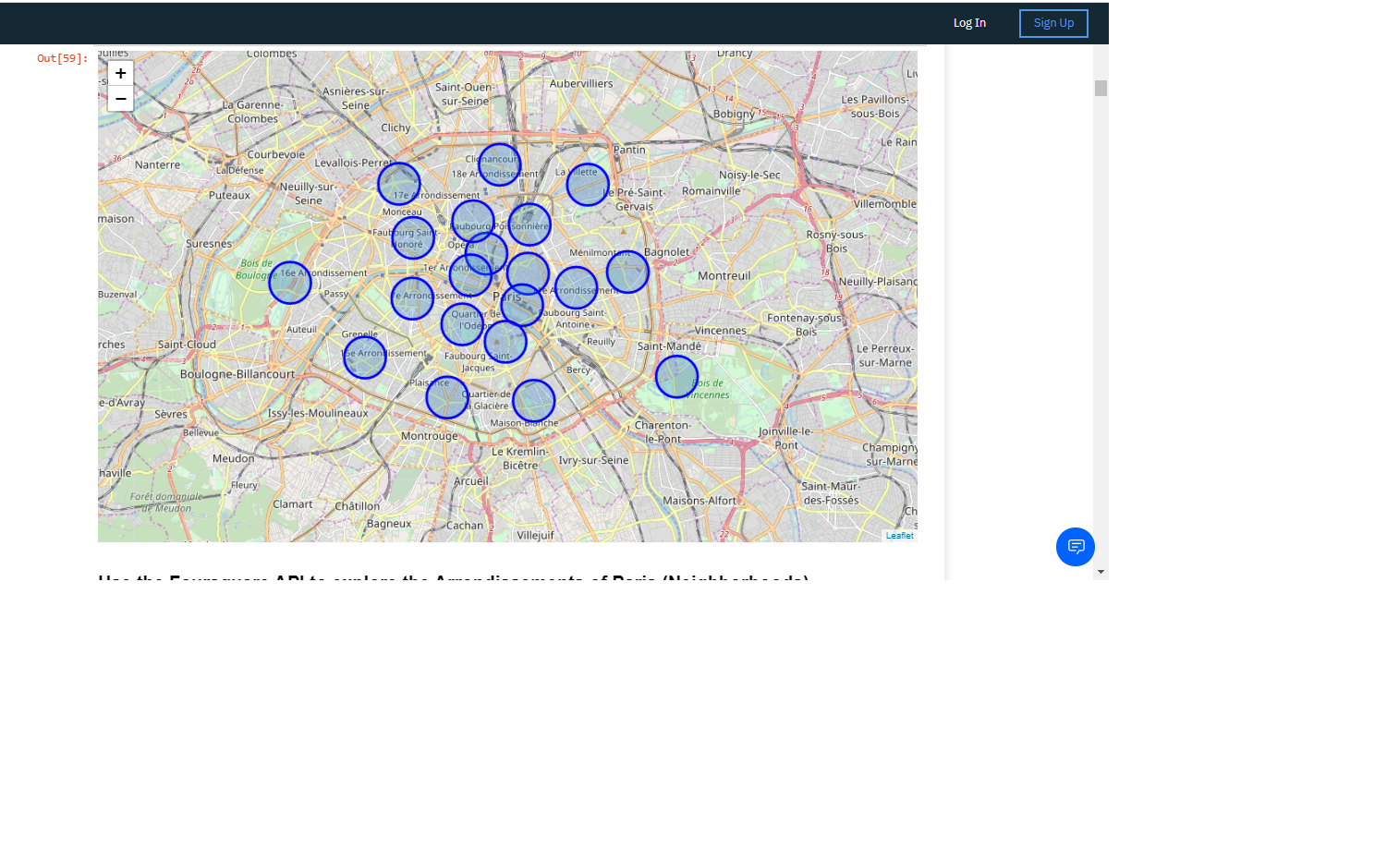

Slide 10
Observations
I guess it's not a surprise that these districts are all very centrally located in the circular arrangement of Paris's arrondissements.
Locations fitting the criteria for popular venues would normally be in central locations in many cities of the world.
From this visualisation it is clear that on a practical level, with no data to base decisions on, the circle of the 20 districs is very large

Slide 11
Inferences
We have made inferences from the data in making the location recommendations, but that is exactly the point.
There is no right or wrong answer or conclusion for the task at hand.
The job of data analysis here is to steer a course for the location selection of new stores
to meet the criteria of being in neighbourhoods that are lively with abundant leisure venues, and
(ii) to narrow the search down to just a few of the main areas that are best suited to match the criteria.

Slide 12
Conclusions
There are many ways this analysis could have been performed based on different methodolgy and perhaps different data sources.
I chose the method I selected as it was a straight forward way to narrow down the options, not complicating what is actually simple in many ways – meeting the the critera for the surrounding venues, and in my case, domain knowledge I have on the subject.
I originally intended to use the clustering algorythms to cluster the data, but as it progressed it became obvious that this only complicated the task at hand.
The analysis and results are not an end point, but rather a starting point that will guide the next part of the process to find specific store locations.
The next part will involve domain knowledge of the industry, and perhaps, of the city itself. But the data analysis and resulting recommendations have greatly narrowed down the best district options based on data and what we can infer from it.

Slide 13
THANK YOU!!

